Slide 1
Truth
Revelation 19

Slide 2
The Vital Role of Truth
Truth
Justice
Economy
Democracy
Free Will Choice
Trust
Love

Slide 3
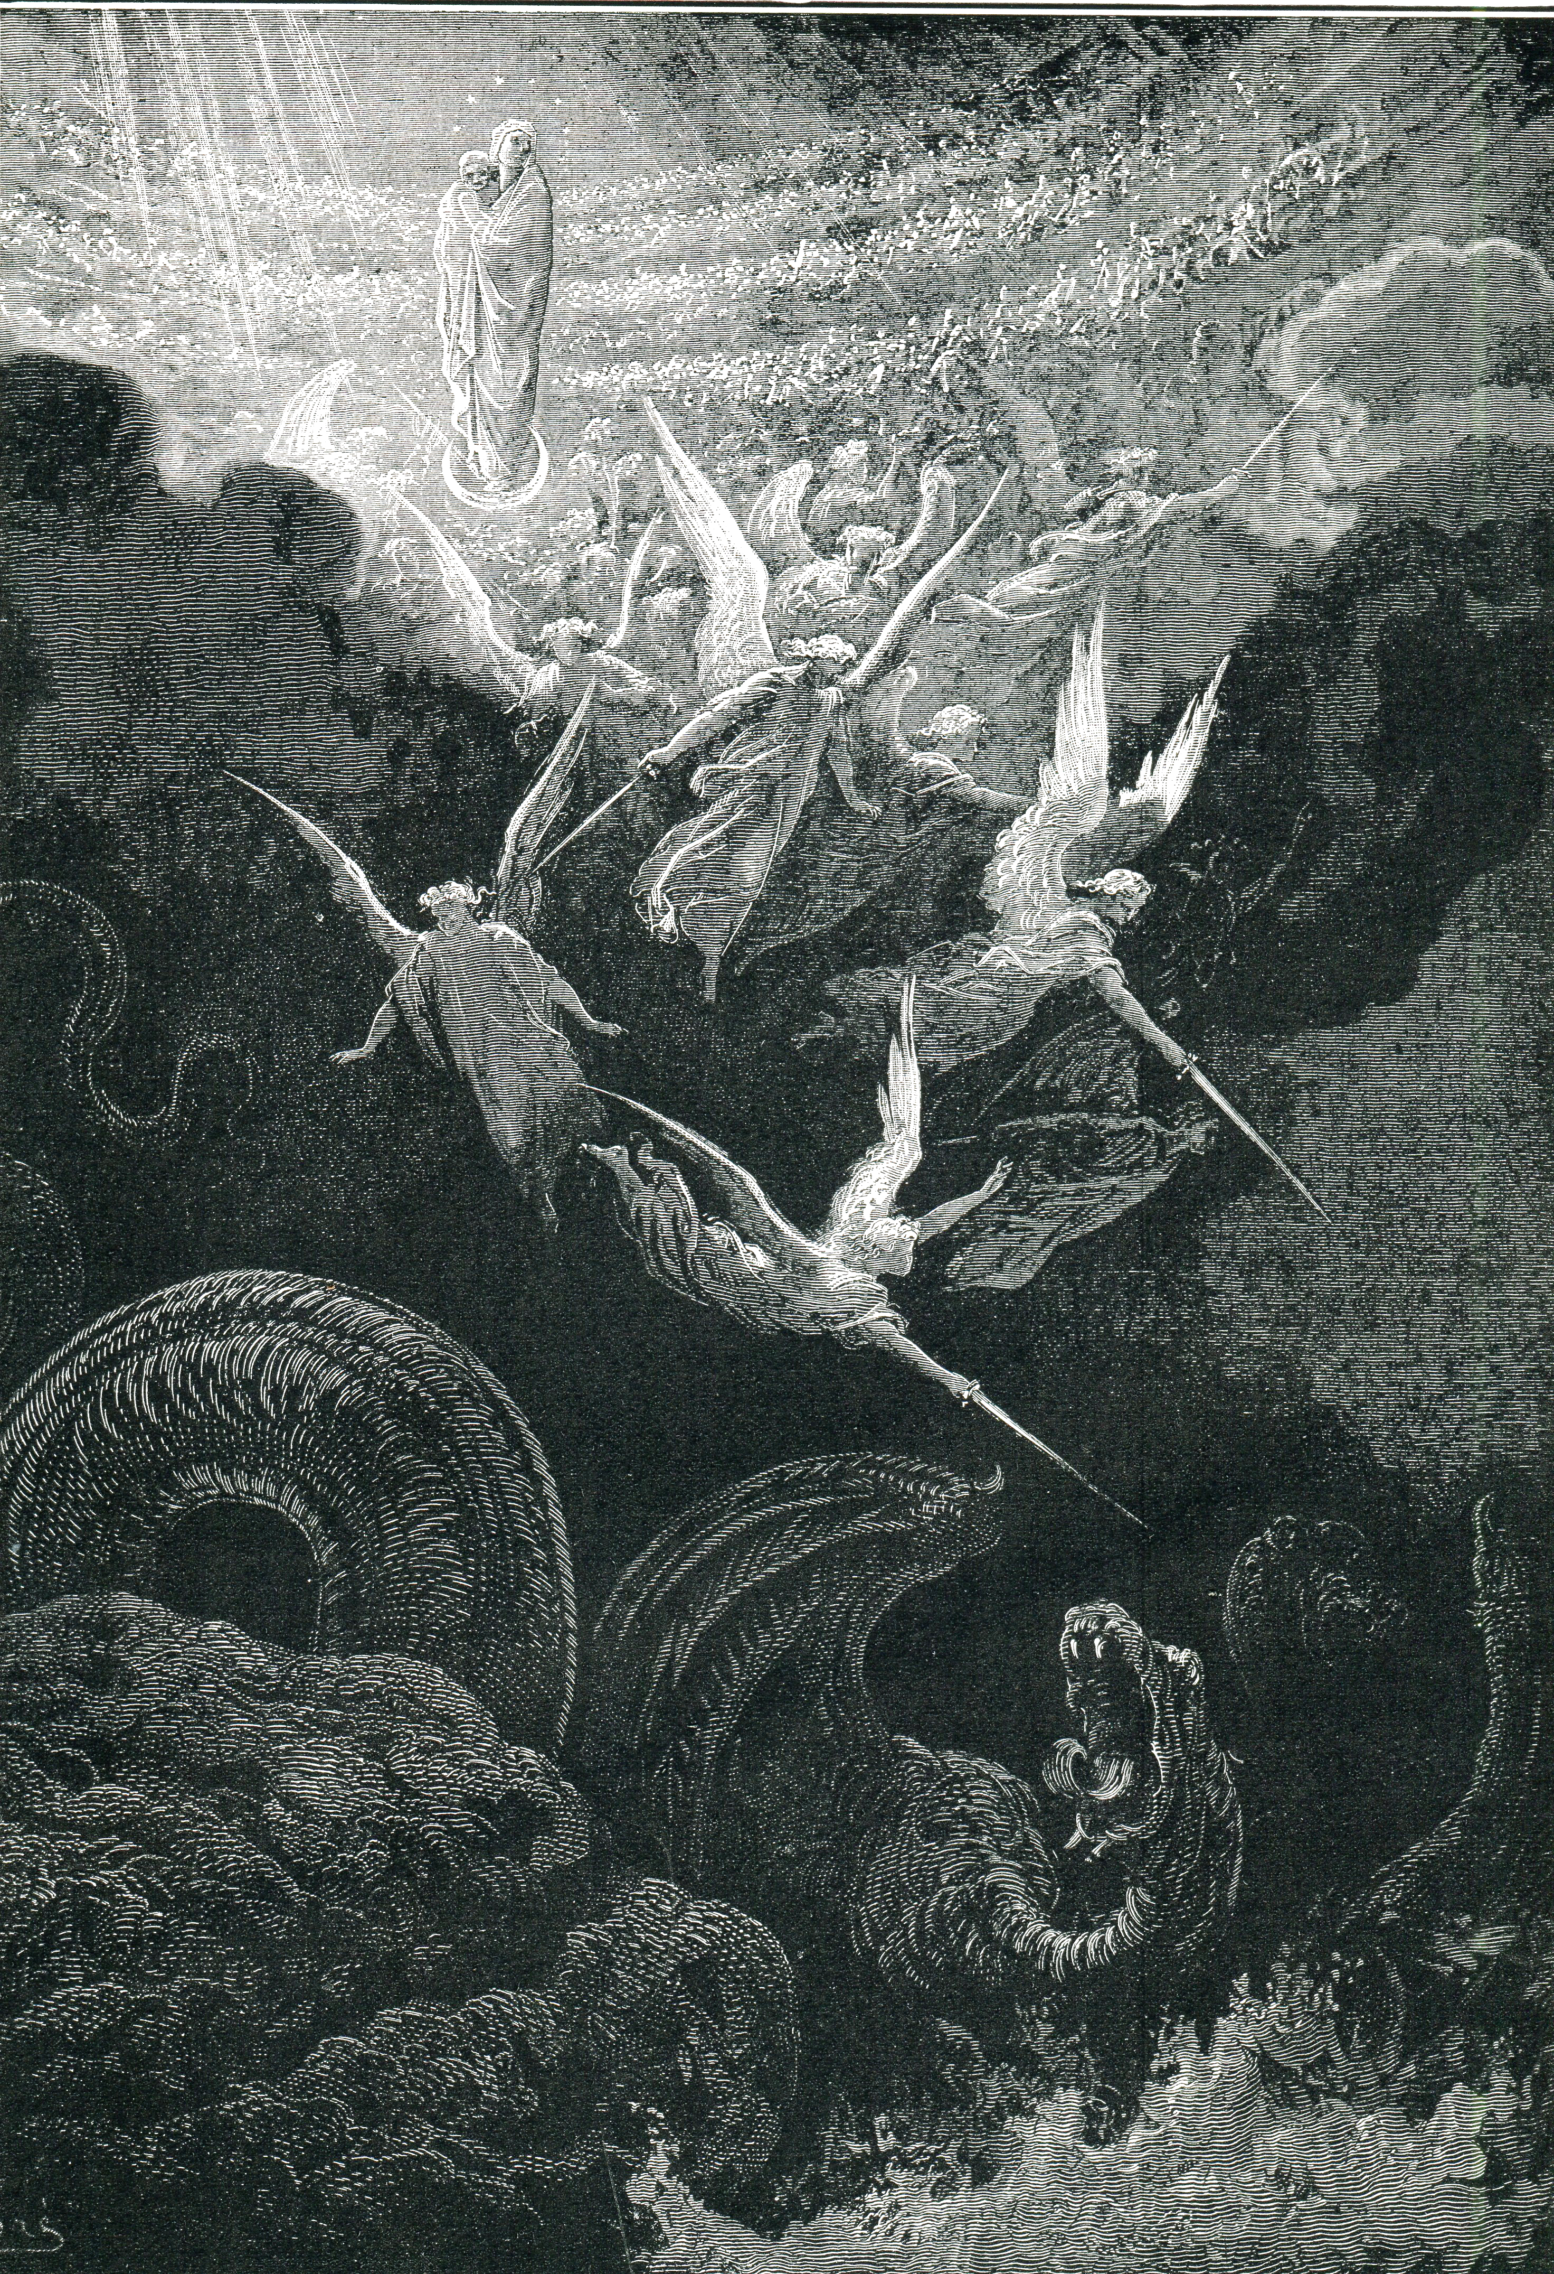
The Problem With Truth
Today:
Revelation 12:9 And the great dragon was thrown down, the serpent of old who is called the devil and Satan, who deceives the whole world; he was thrown down to the earth, and his angels were thrown down with him.
The Future:
Revelation 13:13-14 He did astounding miracles, even making fire flash down to earth from the sky while everyone was watching. And with all the miracles he was allowed to perform on behalf of the first beast, he deceived all the people who belong to this world…

Slide 4
The Problem With Truth
Google Effect
Facebook Effect
Lower rates of recall
Cognitive (critical) thinking
Adolescent brain development
Interrelationships
Depression, Anxiety, Mood Swings

Slide 5
God’s Solution: “The King of Truth”
John 18:37 Pilate said to Him, "So You are a king?" Jesus answered, "You say correctly that I am a king. For this I have been born, and for this I have come into the world, to testify to the truth. Everyone who is of the truth hears My voice."
John 18:38 Pilate *said to Him, "What is truth?" And when he had said this, he went out again to the Jews and *said to them, "I find no guilt in Him.”
Notes:
“…King?’ = Rome’s ANXIETY → JC: “K. of Truth” = REVEALS
“..??Truth??” → Pilate ~Care re: Truth →GOSP: U Care?
JC Already Answered Question
“…no guilt” → Can’t PROCESS it
So they KILLED Him→ the King of Truth

Slide 6
God’s Solution: “The King of Truth”
Revelation 19:9 Then he *said to me, "Write, 'Blessed are those who are invited to the marriage supper of the Lamb.'" And he *said to me, "These are true words of God."
Revelation 19:10 Then I fell at his feet to worship him. But he *said to me, "Do not do that; I am a fellow servant of yours and your brethren who hold the testimony of Jesus; worship God. For the testimony of Jesus is the spirit of prophecy."
After:
The ‘Great Catch’
The ‘Bema Seat’
Notes:
“..Supper” = After **RAPTURE → BOC=In Heaven During TRIB.
After **Bema=REWARDS=Straighten HIS Ppl Out 1st
**SCARY Angel=Like U & I → ALL Proph=JC

Slide 7
God’s Solution: “The King of Truth”
History Is
Linear
With Purpose
Human Life Is
Linear
With Purpose
Revelation 19:9 Then he *said to me, "Write, 'Blessed are those who are invited to the marriage supper of the Lamb.'" And he *said to me, "These are true words of God."
Revelation 19:10 Then I fell at his feet to worship him. But he *said to me, "Do not do that; I am a fellow servant of yours and your brethren who hold the testimony of Jesus; worship God. For the testimony of Jesus is the spirit of prophecy."
Notes:
=BIG DEAL→Flow of HISTORY=JC→ **Linear, ~Cyclical=ABSURD
**Direction, ~Chaos
**UR Place In History=Linear → **Purpose (If U Wanna)
AP: Depressed? Confused? → U NEED PURP, ~Imaginary, ~LIES
Solution=Get on Same Page w/ JC

Slide 8
The Direction of History
Acts 1:6-8 So when they had come together, they were asking Him, saying, "Lord, is it at this time You are restoring the kingdom to Israel?" He said to them, "It is not for you to know times or epochs which the Father has fixed by His own authority; but you will receive power when the Holy Spirit has come upon you; and you shall be My witnesses both in Jerusalem, and in all Judea and Samaria, and even to the remotest part of the earth."
Notes:
“…to Israel” = “What About ME? My THRONE?”
JC: “??About THEM??” → AP: G’s Will=Get Head Straight
AP: Stop Tweeting / Surfing Web / Facebook / Stimulation
INSTEAD → Pursue G’s Will = Concern 4 Humanity
AP: #1) Get H.S. Power #2) Help Build Witnesses=CG/HC/CT
#3) Send Out Witnesses → IGL / Leaders / Teachers / Helpers

Slide 9
The Direction of History
Acts 1:9-11 And after He had said these things, He was lifted up while they were looking on, and a cloud received Him out of their sight.
And as they were gazing intently into the sky while He was going, behold, two men in white clothing stood beside them. They also said, "Men of Galilee, why do you stand looking into the sky? This Jesus, who has been taken up from you into heaven, will come in just the same way as you have watched Him go into heaven."
Notes:
That SUCKS!! ??What??
** “…Coming Again”

Slide 10
The Direction of History
2000 Years Later
More ‘sophisticated’ knowledge
More complex church institutions
More deceit, corruption, confusion
Acts 1:9-11 And after He had said these things, He was lifted up while they were looking on, and a cloud received Him out of their sight.
And as they were gazing intently into the sky while He was going, behold, two men in white clothing stood beside them. They also said, "Men of Galilee, why do you stand looking into the sky? This Jesus, who has been taken up from you into heaven, will come in just the same way as you have watched Him go into heaven."
Notes:
=View of 1st C Xians… → Driven → Excited → “Martyrs”
**2000 yrs ** Sophisticated= “Long Time…”
** Institut→They=Primitive ** Corruption→ DEAD Churches
Busy Building R Own Kingdoms → Nd. THEIR VIEWPOINT
We=PRIV: !) WOG 2) History=Kingdoms Fail 3) Fulfilled Proph

Slide 11
The Direction of History
Revelation 19:11-13 And I saw heaven opened, and behold, a white horse, and He who sat on it is called Faithful and True, and in righteousness He judges and wages war. His eyes are a flame of fire, and on His head are many diadems; and He has a name written on Him which no one knows except Himself. He is clothed with a robe dipped in blood, and His name is called The Word of God.
Matthew 10:26 "Therefore do not fear them, for there is nothing concealed that will not be revealed, or hidden that will not be known.
1 Corinthians 4:5 Therefore do not go on passing judgment before the time, but wait until the Lord comes who will both bring to light the things hidden in the darkness and disclose the motives of men's hearts
Notes:
THIS=Direction of HIST→GET WITH IT→King=JC
Diadems=KING of Truth
Blood=HIS OWN → “Word” =JC → JOHN Preview
Eyes=Discernment → **1Co.4 Sees Into Your SOUL
** REVEALED = TRUTH

Slide 12
The “Victory of Truth” Means…
How do you explain your personal history?
Life makes sense when your history is tied to the flow of real history.
Luke 11:23 “…he who does not gather with Me, scatters. “
Revelation 19:16 And on His robe and on His thigh He has a name written, "KING OF KINGS, AND LORD OF LORDS."
Hebrews 12:26 And His voice shook the earth then, but now He has promised, saying, "YET ONCE MORE I WILL SHAKE NOT ONLY THE EARTH, BUT ALSO THE HEAVEN."
Notes:
Ur History=World Hist: Chaos? Mistakes? Cynical? = DECEIVED
AP: GET UR HEAD OUT OF “MY LIFE” → u Fit in2 WORLD Hist
** Make Sense of your life ** Scatters=ARMAGEDDON
** King of Kings= WHOSE KINGDOM R U BUILDING?

Slide 14
The Direction of History
Confused
Revelation 19:11-13 And I saw heaven opened, and behold, a white horse, and He who sat on it is called Faithful and True, and in righteousness He judges and wages war. His eyes are a flame of fire, and on His head are many diadems; and He has a name written on Him which no one knows except Himself. He is clothed with a robe dipped in blood, and His name is called The Word of God.
Notes:
?? He Do This ?? → ** ~This Way = 2k Yrs Confusion

Slide 15
The Direction of History
Revelation 19:17-19 Then I saw an angel standing in the sun, and he cried out with a loud voice, saying to all the birds which fly in midheaven, "Come, assemble for the great supper of God, so that you may eat the flesh of kings and the flesh of commanders and the flesh of mighty men and the flesh of horses and of those who sit on them and the flesh of all men, both free men and slaves, and small and great." And I saw the beast and the kings of the earth and their armies assembled to make war against Him who sat on the horse and against His army.
Revelation 19:14-16 And the armies which are in heaven, clothed in fine linen, white and clean, were following Him on white horses. From His mouth comes a sharp sword, so that with it He may strike down the nations, and He will rule them with a rod of iron; and He treads the wine press of the fierce wrath of God, the Almighty. And on His robe and on His thigh He has a name written, "KING OF KINGS, AND LORD OF LORDS."

Slide 16
The “Victory of Truth”
In the Middle of Armageddon
To Save Human Life
Haters of God Will Be Seized
JC Wages War By Truth, Right-ness
"Come, assemble for the great supper of God, so that you may eat the flesh of kings and the flesh of commanders and the flesh of mighty men and the flesh of horses and of those who sit on them and the flesh of all men, both free men and slaves, and small and great."

Slide 17
The “Victory of Truth”
In the Middle of Armageddon
To Save Human Life
Haters of God Will Be Seized
JC Wages War By Truth, Right-ness
Matthew 24:22 "Unless those days had been cut short, no life would have been saved; but for the sake of the elect those days will be cut short.
Notes:
2 SAVE, ~KILL!

Slide 18
The “Victory of Truth”
In the Middle of Armageddon
To Save Human Life
Haters of God Will Be Seized
JC Wages War By Truth, Right-ness
Revelation 19:19-20 And I saw the beast and the kings of the earth and their armies assembled to make war against Him who sat on the horse and against His army. And the beast was seized, and with him the false prophet who performed the signs in his presence, by which he deceived those who had received the mark of the beast and those who worshiped his image; these two were thrown alive into the lake of fire which burns with brimstone.
Revelation 19:14 And the armies which are in heaven, clothed in fine linen, white and clean, were following Him on white horses.
1 Corinthians 6:2 Don’t you realize that someday we believers will judge the world? And since you are going to judge the world, can’t you decide even these little things among yourselves?
Notes:
Beast=SEIZED → ALIVE → ** U&I=Armies=LINEN=WEAPONS?
**?? Wage War Against G?? → Fighting Each Other→COPS ARRIVE
U & I = Supernatural!!
** 1Co.6 = ACT like GROWNUPS → ~Petty Strife / Complaints

Slide 19
The “Victory of Truth”
In the Middle of Armageddon
To Save Human Life
Haters of God Will Be Seized
JC Wages War By Truth, Right-ness
Revelation 19:21 And the rest were killed with the sword which came from the mouth of Him who sat on the horse, and all the birds were filled with their flesh.
Revelation 19:11 …He who sat on it is called Faithful and True, and in righteousness He judges and wages war.
Revelation 19:15 From His mouth comes a sharp sword, so that with it He may strike down the nations, and He will rule them with a rod of iron..
Can’t Talk
Notes:
** Sword ~METAL
** Rev.19=SAME=Rev. 1
**Rev.19:11=RIGHT-NESS, ~Guns

